Slide 1
The Use of Global Standards Solutions in the Fight against Illicit and Counterfeit Products
Michele Francis Padayachee
Global Standards, Solutions and Tech Executive
14 May 2025

Slide 2
GS1 is a global standards organisation
that helps companies do business
across the world
Global community
25 industries served
More than 2 million companies
118 Member Organisations
GS1 Global Office
Our Impact
10 billion GS1 barcodes scanned daily
1 billion products carry GS1 barcodes
More than 2 million companies use GS1 standards
Inclusive and collaborative

Slide 3
Photo right side
The fight against counterfeiting and illicit trade is a task that must involve everyone, and GS1 is collaborating with authorities, security and policing clusters, member companies, solution providers and relevant stakeholders so that the GS1 standards can be a valuable element of any solution to detect, deter and dismantle illegal activities.
Notes:
The Counterfeit Goods Act is a crucial piece of legislation aimed at protecting consumers from the harmful and misleading trade in counterfeit goods. Counterfeit goods always bear trade marks registered with the CIPC, misleading consumers into believing they are purchasing genuine products. While the majority of confiscated counterfeit items tend to be clothing and footwear, there is a growing concern about counterfeit consumer goods, such as food and beverages, which pose significant risks to public health and safety. These items, when consumed, can directly affect our well-being, highlighting the urgency of effective enforcement. Found in our markets placed are mostly yeast , sanatory products and alcoholic beverages.
Enforcement is currently carried out through a multi-agency task team, adopting a multidisciplinary approach to address the complex challenges of counterfeiting. Agencies such as the National Consumer Commission (NCC) the NRCS, SAPS, SARS Department of Home Affairs SAHPRA, ICASA and municipal authorities collaborate to address various contraventions, from violations of the Counterfeit Goods Act to municipal by-law infractions and each one their own laws. The National Anti-Counterfeiting Task Team (NACTT), recently appointed by SAPS, typically takes the lead in operations with CIPC providing extensive strategic direction, with a focus on building capacity and training in the area of IP Law enforcement. With their manpower and resources, SAPS plays a critical role in providing security and facilitating access for other agencies to perform their duties effectively.
An alarming trend has emerged in recent months : nearly 99% of suspects apprehended for dealing in counterfeit goods are foreign nationals, often holding only asylum-seeking permits. Compounding this issue is the disturbing rise of local manufacturing operations producing counterfeit goods, adding a new layer of complexity to enforcement efforts.
To strengthen enforcement and enhance coordination, there is a need to centralize the task team’s operations by creating a unified structure, akin to the Enforcement Coordinator model used in the United States. Such a model would involve task team members from various agencies working together in a single office, enabling more streamlined communication, collective decision-making, and more efficient enforcement of legislative requirements. This approach mirrors the successful implementation of the "Twin Peaks" model in South Africa’s financial sector, which brought together regulators under a unified framework to tackle complex financial sector challenges.
Included is a draft plan for your input and consideration and to incorporate into the existing structures and plans that you are working on. Do not hesitate to reach out should you require any further input.

Slide 4
GS1 Standards Collaboration
…wide range of stakeholders
Authorities
Local Authorities , In the EU 2018/574, “Product number – numeric identifier used in EU system sto identify product presentations (e.g. GTIN (Global Trade Identification Number) of the product.
Retailers, distributors, wholesalers
Supports backwards compatibility with retail supply chain scanners and master data used within orders, invoices, and payments
Manufacturers
Can be printed by high-speed, inline production/printing systems
Customs officials
Permits a primary link between packaging ID and shipping manifests
All
Provides scalable, interoperable, faster implementation with less disruption and cost, using open, supply chain standards deployed pervasively today.

Slide 5
European Union Intellectual Property Office

Slide 7
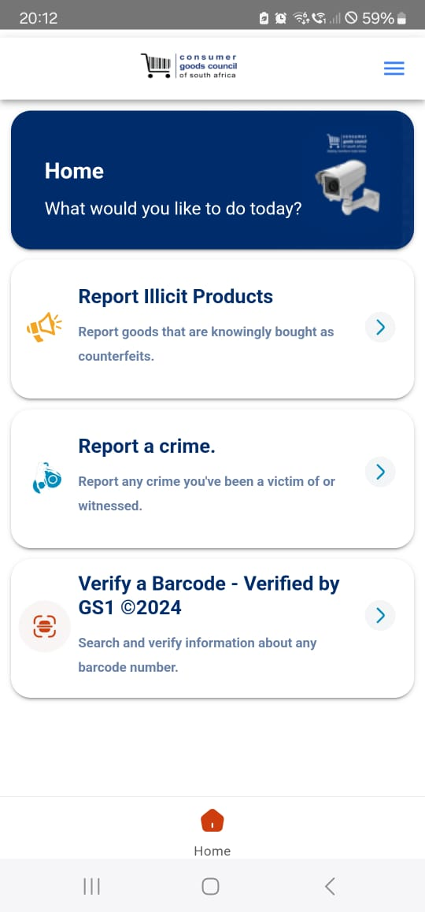
Verified By GS1 Registries

Slide 8
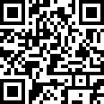
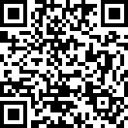
Download App
Apple Store
Google Play Store

Slide 9
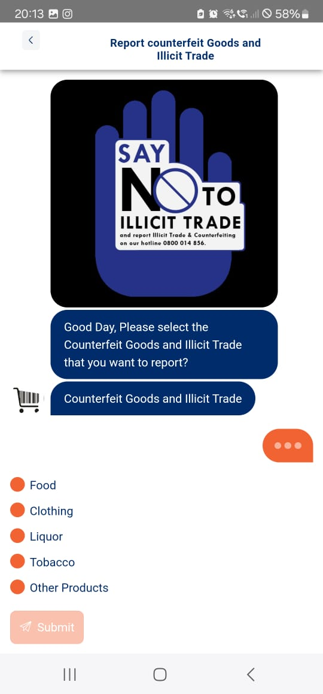
MyCGCSA App Linked to Verified By GS1

Slide 10
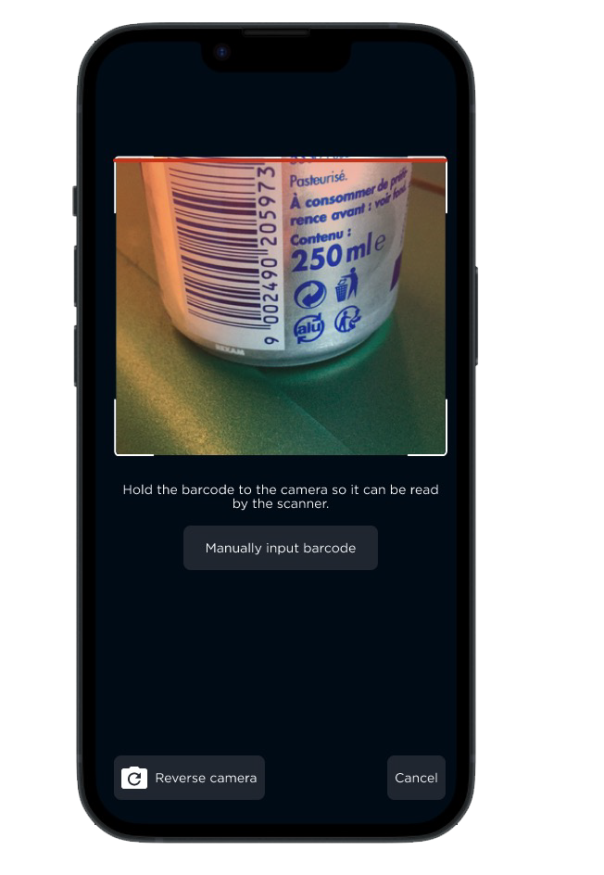
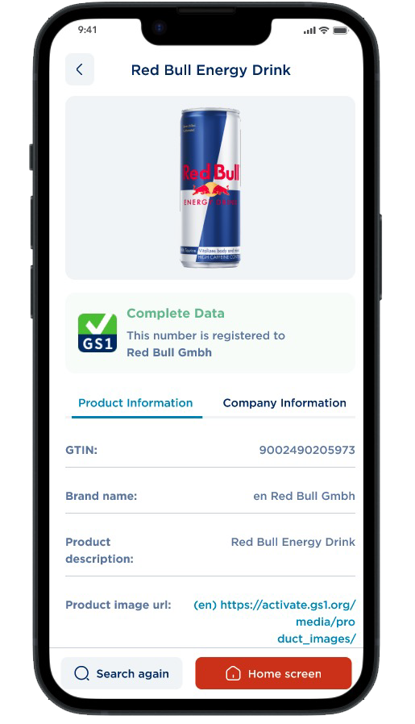
Verified By GS1 in Action
Scanning the can
Product details
South Africa

Slide 11
CHECKA DAAI DING, REAK MAKOYA
A Campaign to build awareness in communities
Interviews on Local Radio Stations
Team out to communities

Slide 12
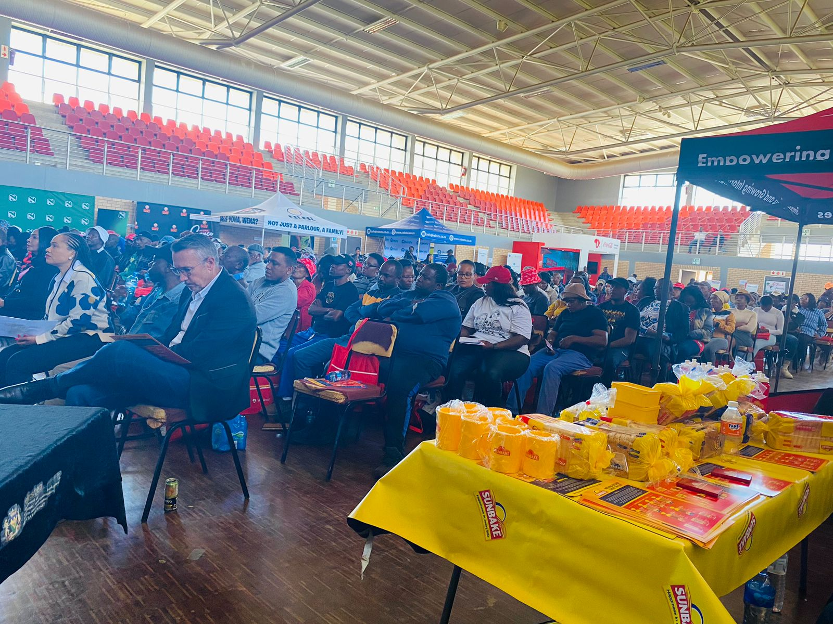
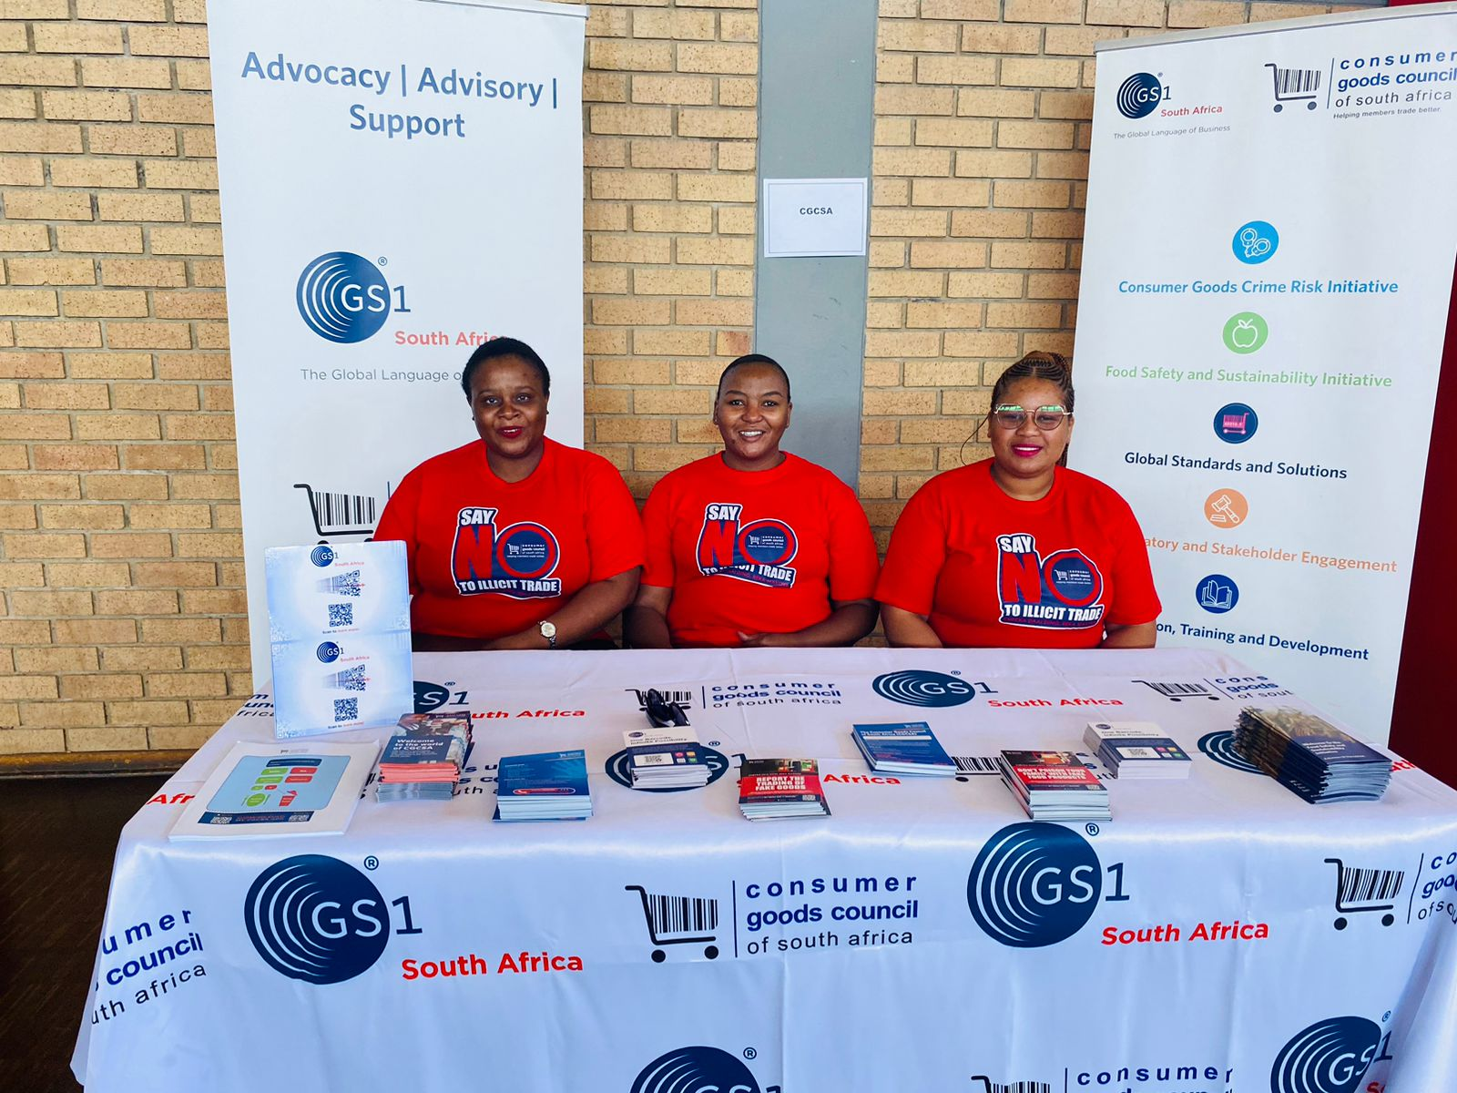
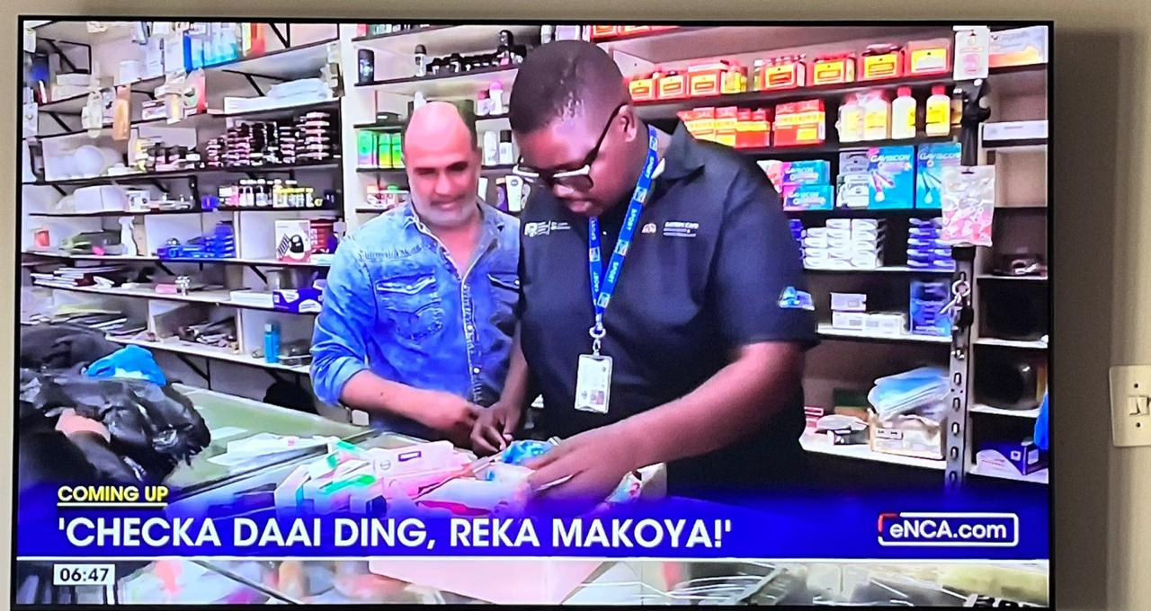
What happening Locally !
X
of shoppers switch brand if low quality information
X
of shoppers switch brand if low quality information
X
of shoppers switch brand if low quality information
Training and Awareness
Illicit Campaign
Media and Local Radion Stations
Notes:
https://youtu.be/W_vl95
I always stress in the various workshops that GS1 is the language, but the solution in itself and the hardware, are not provided by GS1. The GS1 traceability system provides additional tools but will never prevent counterfeit in itself, GS1 only makes its detection easier

Slide 13
MyCGCSA App Stats

Slide 14
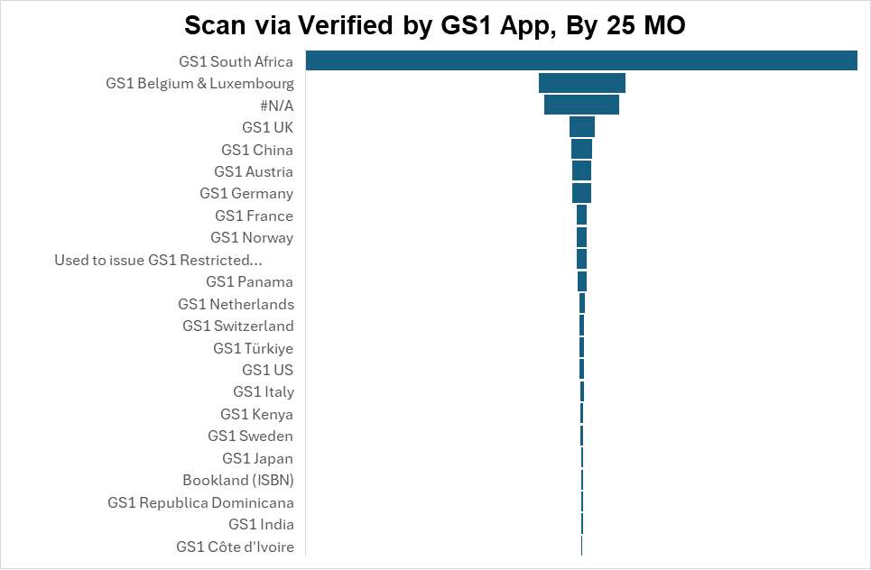
Scannable Data Insights

Slide 15
Scannable Data Insights

Slide 16
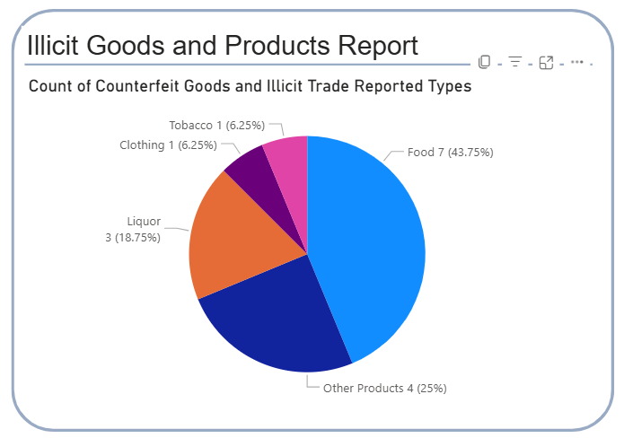
What are we prepared to do
Call to Action to Report Incidents

Slide 17
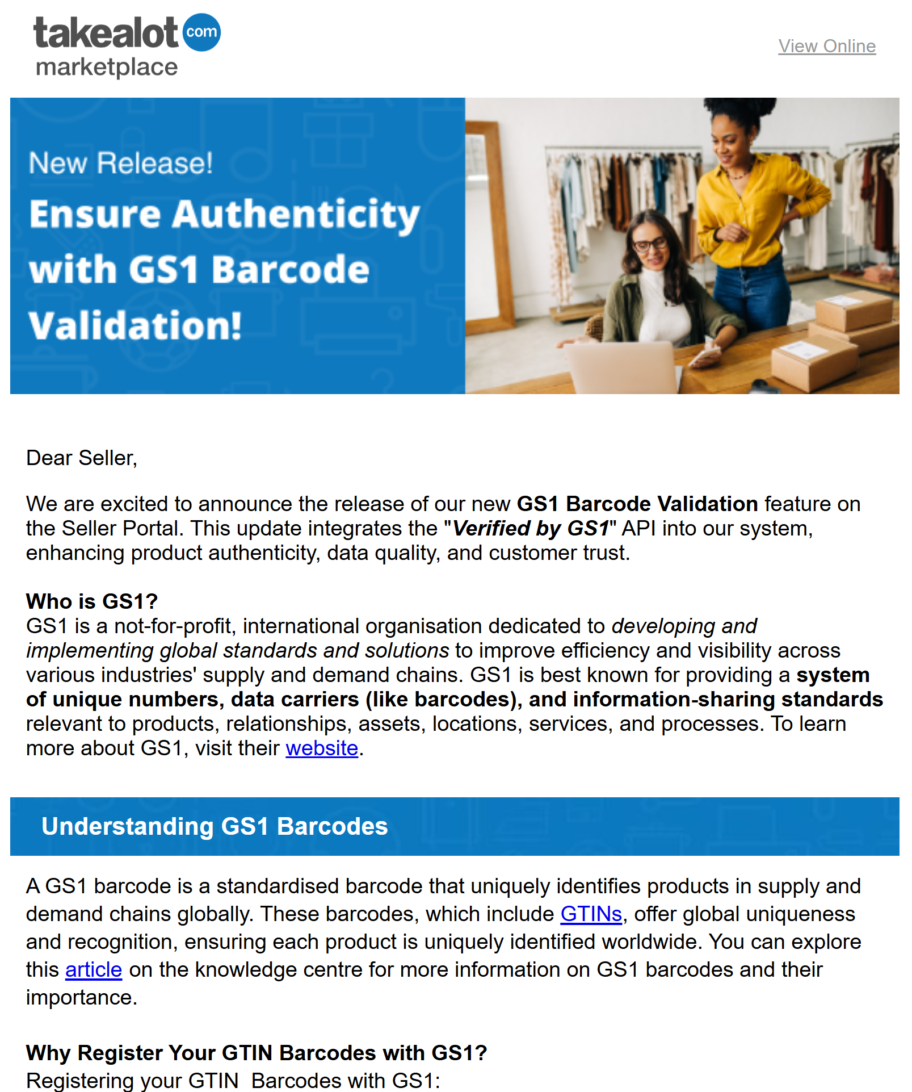
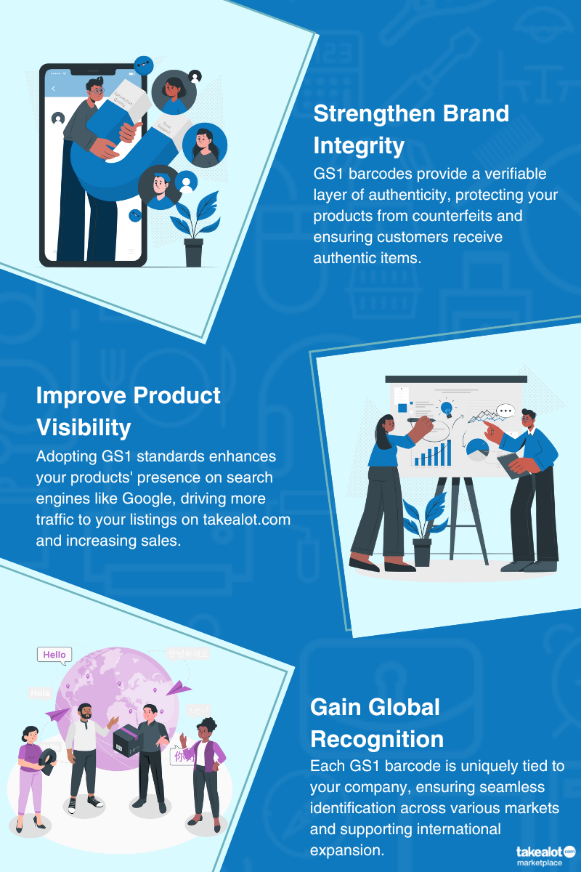
Take A Lot – using Verified By GS1 Registry

Slide 18
Q&A

Slide 19
Thank you!
Contact Details
Michele Francis Padayachee
Michele.Padayachee@gs1za.org

